Slide 1

How Weather Impacts Daily Bike Rental Demand
INFO6105 Data Sci Eng Methods Final Project By: Sameeth Kumar Goud Talla
NU ID: 002810105

Slide 2
Introduction & Dataset Overview
Urban bike-sharing is growing fast
Goal - Understand demand drivers based on weather and calendar variables
Dataset - UCI ML Repository (2011–2012, daily)
Total Observations - 731 days
Features - temp, humidity, windspeed, season, weather
Targets - cnt (total rentals), high_demand (binary)

Slide 3
Techniques and Workflow
Data Preparation - Base R and dplyr were used and made a binary categorization label.
Linear Regression - Weather and calendar variables are used to model a continuous outcome (cnt).
Logistic Regression - Used specific predictors are to classify demand as either high or low.
Decision Tree - Developed with Rpart to provide comprehensible rule-based categorization.
Cross-validation - The stability of the model was confirmed using a 5-fold caret.
Visualization - Performed using ggplot2 and base plotting functions.

Slide 4
Linear Regression Insights
Formula: cnt ~ temp + hum + windspeed + season + weathersit + holiday + workingday
Temperature - Strongest positive impact on rental volume.
Humidity & and Windspeed - inversely connected with rental income.
R-squared - 0.522 & Adjusted R-squared - 0.517
shows that more than 50% of the volatility in rental counts may be explained by the weather and season.

Slide 5
Logistic & Decision Tree Models
using a logistic algorithm to classify high demand.
Accuracy of the test: 72.7%, CV: 77.9% (caret)
Top Predictors for Decision Trees: - Temperature (42), Season (28), Humidity (16), and Windspeed (9)
Example of the Tree Rule: High demand if hum < 0.74 and temperature > 0.43
Both models exhibit interpretability and dependability.

Slide 6
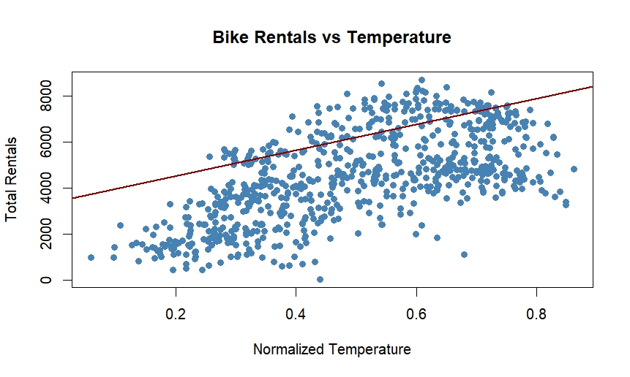
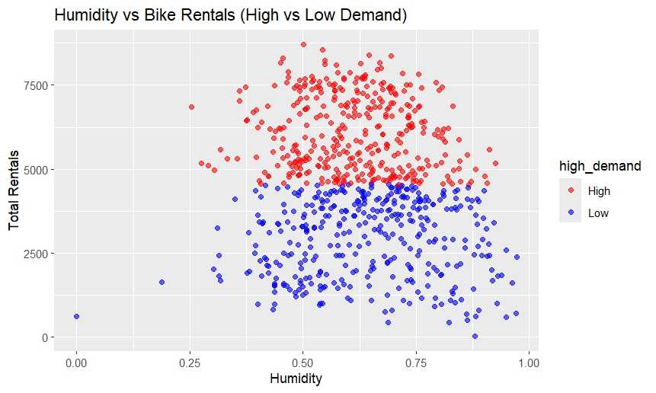
Rentals vs Temperature & Humidity
Bike Rentals vs Temperature - More rentals on warmer days.
Humidity vs Demand (Red = High, Blue = Low) - High demand on moderate humidity days.

Slide 7
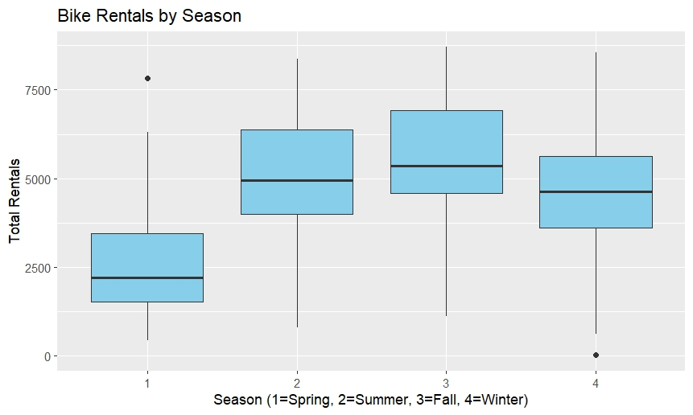
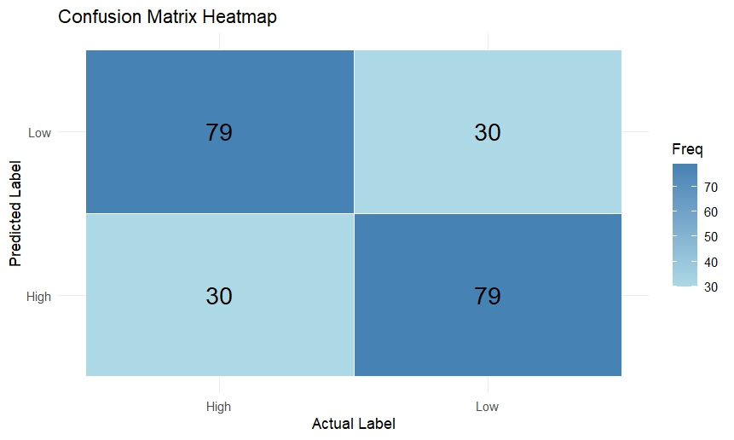
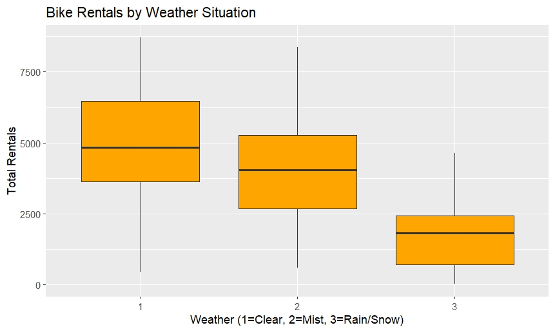
Rentals by Season, Weather, and Accuracy
Rentals by Season - Fall/Summer have higher medians.
Confusion Matrix - Balanced classification accuracy for High/Low.
Rentals by Weather - Clear weather = higher rentals.

Slide 8
Key Findings & Recommendations
Weather Impact - Wind and excessive humidity lower demand, whereas temperature has the biggest impact.
Model Accuracy - Forecasts from logistic and tree models are both accurate.
Use Case - Aids in forecasting, bike deployment, and staff scheduling.
Scalability - Model can generalize to other cities and datasets.

